Slide 1
Effectiveness of Amniotic Fluid Injection for Low Back Pain
Glenn R. Buttermann, MD, MS
Midwest Spine & Brain Institute
Louis C. Saeger, MD
Matthew G. Thorson, MD
Advanced Spine and Pain Clinics of Minnesota
ISASS 2020

Slide 2
Disclosures
Vivex donated product for our IRB-approved study of Epidural Amniotic Fluid Injections
Glenn R Buttermann, MD
  Consultant, Dio Medical
  Licensing Agreement, FG Solco
Louis C Saeger, MD
  Travel expenses, Vivex
Matthew G. Thorson, MD
  None

Slide 3
Why is amniotic fluid (AF) of interest in the treatment of discogenic & radicular pain?
Current treatment options are limited:
  Tincture of time
  Manipulation
  Physical Therapy/Exercise
  Spinal steroid injections
  Surgical discectomy and/or fusion

Slide 4
Why is amniotic fluid (AF) attractive for treatment of discogenic & radicular pain?
Stated simply: Amniotic Fluid injections may have potent anti-inflammatory and regenerative properties without the risks of steroid-related side effects

Slide 5
Background Review
Biochemical and physiological properties of AF
Preliminary data from in vitro and animal studies
Suggestive evidence from other clinical applications
Anecdotal evidence for efficacy and safety in clinical use for epidural and intra-discal injection

Slide 6
Summary of Protein Milieu
Inflammatory proteins to scavenge/digest trauma debris and initiate repair.
Anti-inflammatory proteins to prevent scar and excessive fibrosis.
Growth factors for continued optimal repair.

Slide 7
Commercially Available AF Contains Interesting Constituents
AF preparations for the use under discussion is a chorion-free, cryopreserved allograft derived from amniotic membrane and fluid, but the preparations do not contain living mesenchymal stem cells.
Contains: collagen substrates, growth factors, amino acids, carbohydrates, cytokines, TIMPs, hyaluronic acid, extra cellular matrix, micronized amniotic membrane and exosome products derived from multipotent amniotic cells.
Components potentially promoting tissue regeneration, providing an anti-microbial environment, and anti-inflammatory characteristics with anti-adhesion and anti-fibrotic capabilities.

Slide 8
Biochemistry of AF
Amniotic epithelial cells produce potential regenerative substances :
Transforming growth factor –a (TGF-a), and –b (TGF-b)
Basic fibroblast growth factor (bFGF)
Epidermal growth factor (EGF)
Keratinocyte growth factor
Hepatocyte growth factor
Nerve growth factor(NGF)
Brain-derived neurotrophic factor (BDNF), noggin, and activin have also been identified in the AM

Slide 9
AF contains anti-inflammatory proteins & growth factors

Slide 10
Rationale for use of AF as an alternative to steroids for epidural and intradiscal Injection
Properties of AF confer potent effects, including suppression of inflammation, reduced neovascularization, fibrosis, and scarring without inhibition of healing, as well as potential regenerative effects
Radicular pain associated with intervertebral disc disruption is primarily caused by inflammation
Elements contributing to stenosis result from inflammatory changes
Discogenic pain is assocaited with inflammatory endplate changes
Annular disruption-related sensitization is inflammation-induced
Degenerative changes may be at least partially reversible

Slide 11
Rationale behind our pilot study
    Epidural steroid injections are commonly used for degenerative spinal conditions
    Effectiveness of ESI varies for DDD, stenosis, and HNP
    ESI has risks: high blood glucose levels in diabetic patients, infection, adrenal suppression, stroke, cataracts, etc.
    Amniotic fluid injection is a potential alternative with a better safety profile

Slide 12
Amniotic Fluid Background
AF has long history of demonstrated safety
AF is obtained using sterile technique from volunteers at the time of C-section
Mothers consent to donating AF
Donated AF is filtered, concentrated, serologically tested by UMTB
Stored frozen (with non-DMSO cryoprotectant, particulate-free, and acellular)

Slide 13
Study Purpose:
Define Indications for epidural AF
Question: Do epidural AF injections reduce pain and improve function in patients with low back & leg pain?
IRB-approved for three cohorts:
  HNP
  Stenosis
  DDD
Inclusion criteria:
  >6 weeks symptoms, min LBP VAS 40/100
  Failed conservative care (PT, chiro, meds)
  MRI consistent with clinical Dx and exam

Slide 14
Methods
Cohort Study, 15 patients in each group
Symptoms > 6 weeks
Prospective Outcomes:
  LBP & leg VAS
  Pain Drawing
  ODI
  PROMIS
  pain meds
Follow-up: 2-4 wk, 6-8 wk, 3-4m, 6-8m, and 1 yr

Slide 15
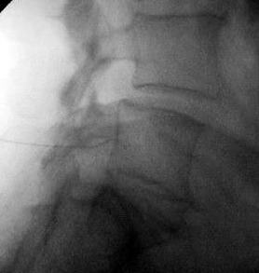
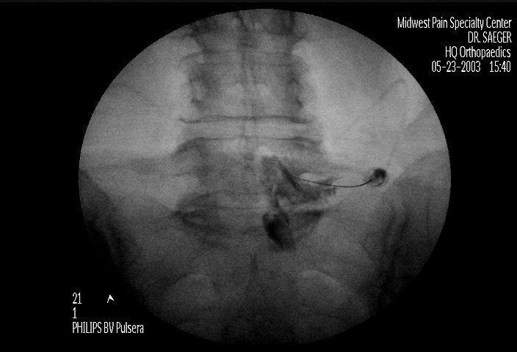
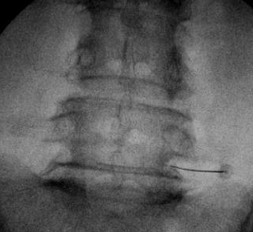
Methods
2 mls thawed AF with 1 ml 4% lidocaine
Mild or no sedation, single injection
Fluoroscopy in multiple planes
Transforminal technique

Slide 16
Results Regarding Safety
Zero dural leaks
Zero infections
Zero transient radiculitis
Zero allergic reactions

Slide 17
Low Back Pain Outcomes

Slide 18
Leg Pain Outcomes

Slide 19
Pain Drawing Outcomes

Slide 20
Disability Outcomes

Slide 21
PROMIS T-scores

Slide 22
Summary of Results
Within Groups
HNP: significant improvement @ all FU, VAS back & leg pain, Pain Diagram, ODI, PROMIS-Phys.
Stenosis: significant improvement @ all FU, VAS back & leg pain, Pain Diagram, ODI, PROMIS-Phys.
DDD: significant improvement at @ all FU, VAS back pain.
Between Groups
No difference in pre-treatment measures.
HNP: significantly greater improvement in VAS back & leg pain, & ODI compared to DDD.
HNP greater leg pain improvement compared to Stenosis.
Stenosis: significantly greater improvement in VAS leg pain compared to DDD.

Slide 23
Is PROMIS useful for studies such as this?
PROMIS® (Patient-Reported Outcomes Measurement Information System) is a set of person-centered measures that evaluates and monitors physical, mental, and social health. It can be used with the general population, and with individuals living with chronic conditions. PROMIS has been advocated for use in spinal fusion outcome studies.
PROMIS T-scores showed that most of our study patients were below average at baseline (i.e., not doing very well).
PROMIS outcomes in this cohort show limited treatment effect, despite significant changes in other measures, so it may not be a sensitive instrument in this study setting.

Slide 24
Treatment Success/Failure
HNP: 70% Success
  2 patients → Other injections
  2 patients → Discectomy
Stenosis: 58% Success
  4 patients → Other injections
DDD: 53% Success
  2 patients → Other injections
  3 patients → Fusion/TDR

Slide 25
Study Limitations
Small numbers
New injuries
Confounding effect of those patients with multi-level degeneration and other potential sources of LBP
Variable opioid tolerance of subjects
Repeat injections not studied

Slide 26
Discussion - Conclusions
Epidural AF injections are safe.
Epidural AF injections are most effective for patients with HNP.
Epidural AF injections may be effective for stenosis.
Epidural AF injections equivocal for DDD (study of intradiscal injection of AF is planned for DDD).
Randomized epidural AF vs steroid study is planned with subanalysis for diabetic patients.

